Slide 1
Flocking Implementation
Creators:
Sam Winter
Adnan Adan
Ermias Cham

Slide 2
Our Plan:
Adnan | Ermias | Sam
Increase circle count | Math for cohesion, separation, alignment | Calculate circle proximity
Increase size of simulation | Modify GUI to include sliders | Removed hardcore bounds/ Flocking Behavior
Challenging Aspects
Putting the math into code for cohesion, separation and alignment
Calculating the distance between circles

Slide 3
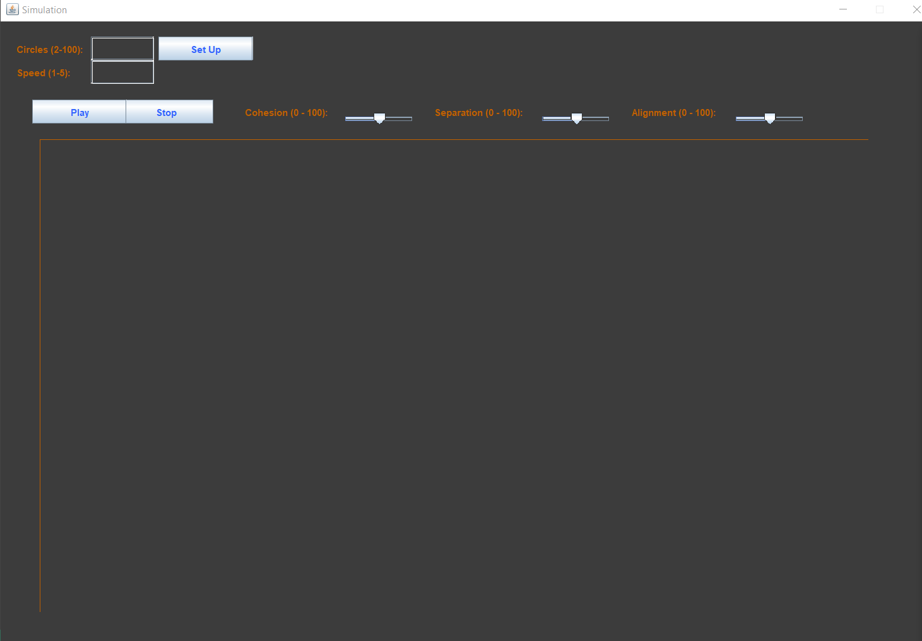
Our GUI:
Size 2-100
Speed 1-5
Sliders:
Cohesion 0-100
Separation 0-100
Alignment 0-100

Slide 4
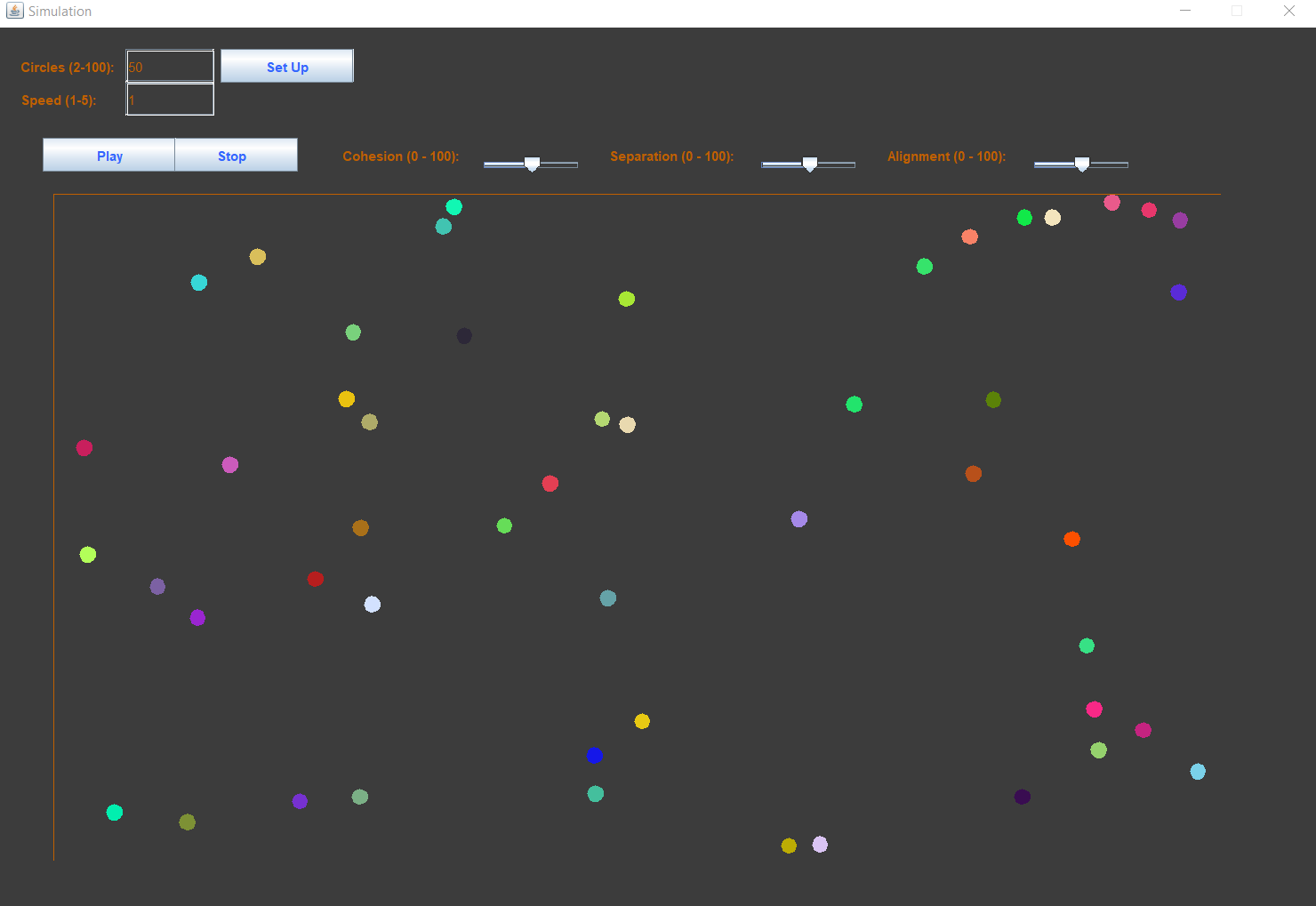
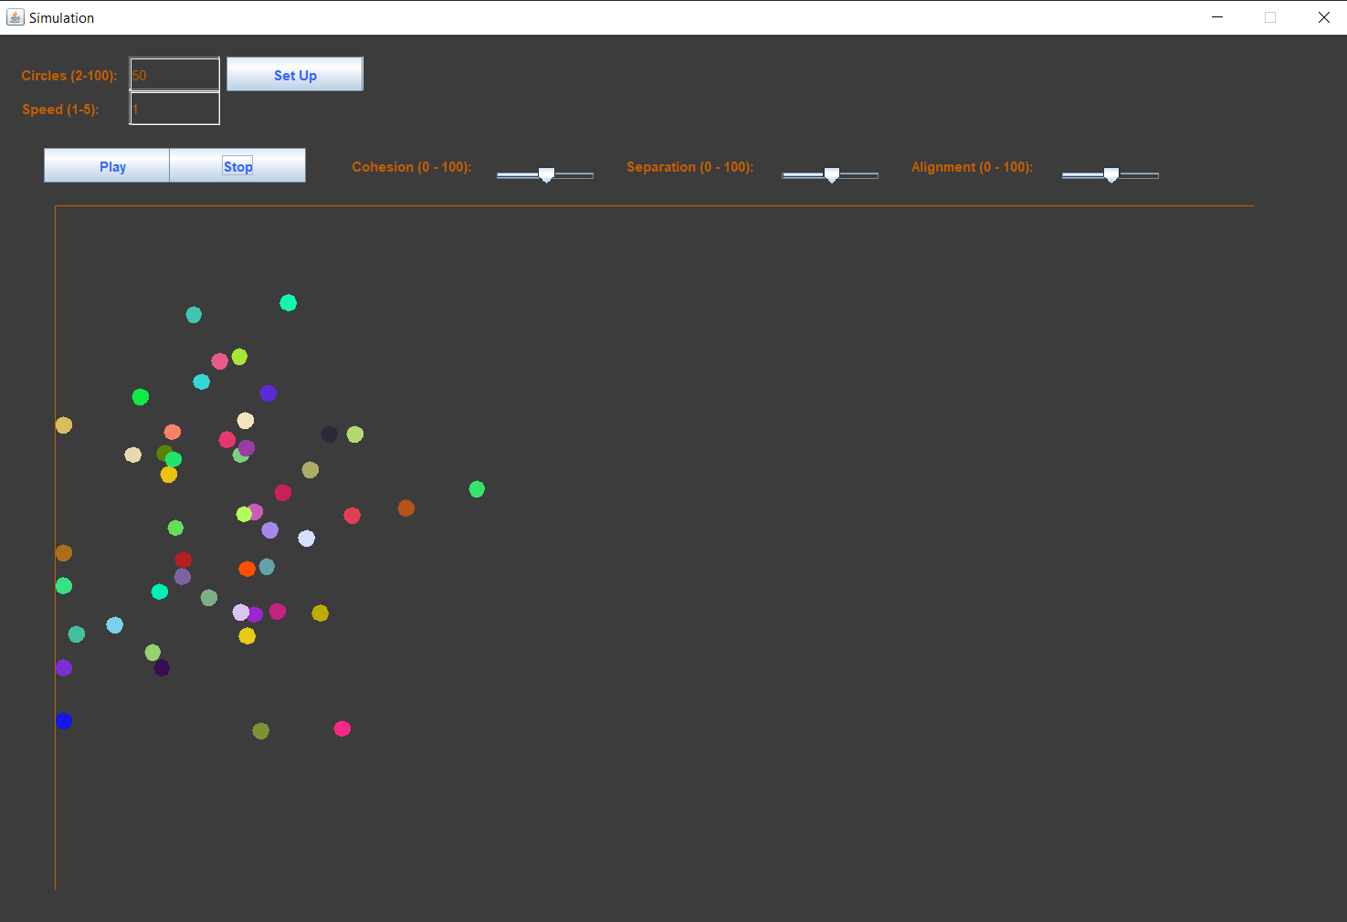
Flocking Behavior:
50 Circles; Speed 1

Slide 5
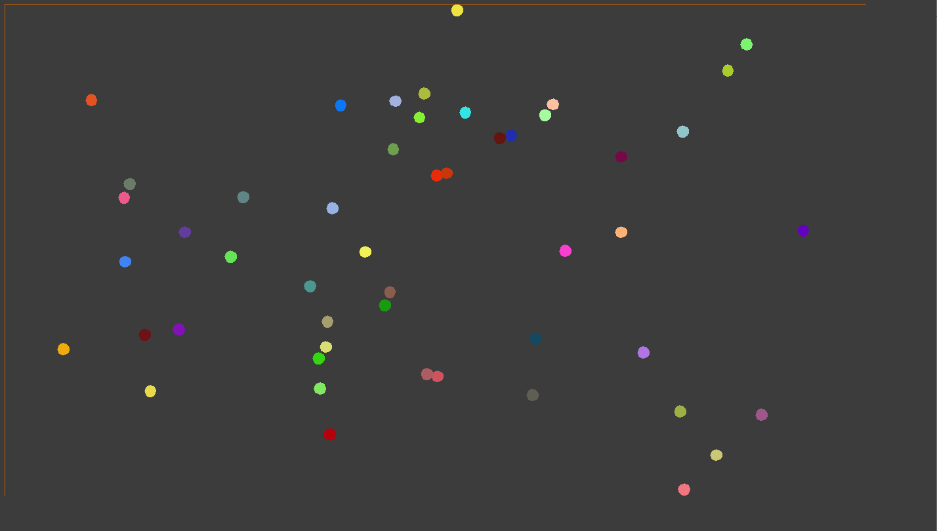
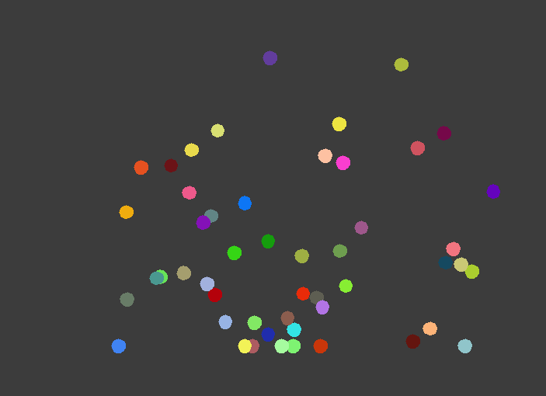
Code Improvements:
Needs Solution:
The circles start to flock
As simulation continues to run, the circles flock less
After a couple seconds the circles are no longer flocking
Ideas for Solution:
Setting a limit in the vector

Slide 6
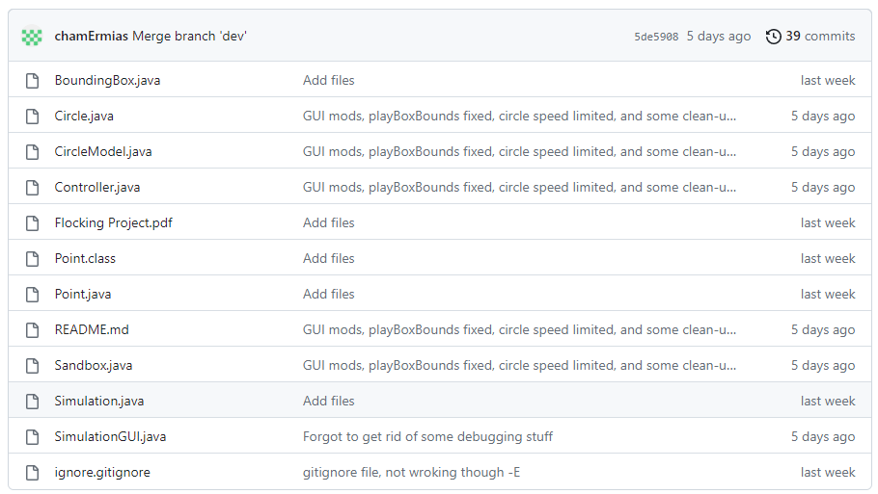
Our Git Repository:
https://github.com/SammyWint/FlockingProject

Slide 7
Our Resources:
Sam
https://www.youtube.com/watch?v=4LWmRuB-uNU (Smarter EveryDay)
https://medium.com/@errazkim/boids-simulation-in-java-407d2e924e1f
https://rosettacode.org/wiki/Boids/Java
Ermias
https://codeheir.com/2021/03/27/the-flocking-algorithm/#:~:text=Flocking%20is%20a%20behaviour%20that,%3A%20 separation%2C%20 alignment%20and%20 cohesion.
https://www.youtube.com/watch?v=mhjuuHl6qHM
https://www.youtube.com/watch?v=LltugBg4dtk
Adnan
https://www.youtube.com/watch?v=bqtqltqcQhw
Additional
https://www.youtube.com/watch?v=QbUPfMXXQIY&ab_channel=dante
https://eater.net/boids
https://cs.stanford.edu/people/eroberts/courses/soco/projects/2008-09/modeling- natural-systems/boids.html

